Slide 1

Scala at a glance
dongjie.shi

Slide 2





“Throughout his career, Martin's singular objective has been to make
the basic job of writing programs faster, easier and more enjoyable.”
javac
scalac
Pizza → Generic Java → Java SE 5
Martin Odersky
Functional Programming Principles in Scala @ Coursera
Functional Programming Theory
Code analysis
Type Systems
Programming language
Concurrent Programming

Slide 3

Pragmatic
since 2003
Sponsored by
seamless java interoperability
Friendly and supportive
Community
Production
ready
Functional
Object-oriented
runs on JVM
Statically typed

Slide 4
Outline
Basics
OOP
FP
Advanced Features

Slide 5
Statically Typed
Type Annotation
Type Inference
Scalable Syntax
Expression-oriented Programming
Immutable Programming
Option type programming

Slide 6
OOP
Class
Object
Trait

Slide 7
class.1
Immutable Objects
Functional Objects
constructor
parameter
class Rational(n: Int, d: Int) extends Ordered[Rational] {
require(d != 0)
private val g = gcd(n.abs, d.abs)
val number = n / g
val denom = d / g
println("Created " + this)
def this(n: Int) = this(n, 1)
def +(that: Rational): Rational = new Rational(this.number * that.denom + that.number * this.denom, this.denom * that.denom)
def +(i: Int): Rational = new Rational(this.number + i * this.denom, this.denom)
def -(that: Rational): Rational = new Rational(this.number * that.denom - that.number * this.denom, this.denom * that.denom)
def -(i: Int): Rational = new Rational(this.number - i * this.denom, this.denom)
def *(that: Rational): Rational = new Rational(this.number * that.number, this.denom * that.denom)
def *(i: Int): Rational = new Rational(this.number * i, this.denom)
def /(that: Rational): Rational = new Rational(this.number * that.denom, this.denom * that.number)
def /(i: Int): Rational = new Rational(this.number, this.denom * i)
def compare(that: Rational) = this.number * that.denom - that.number * that.denom
override def toString = this.number + "/" + this.denom
private def gcd(a: Int, b: Int): Int = if (b == 0) a else gcd(b, a % b)
}
val → def
parameterless methods
private field
public field
constructor
public method
class Rational(n: Int, d: Int)
class Rational(val n: Int, private var d: Int)
case class Rational(n: Int, d: Int)
private method

Slide 8
class.2
Mutable Objects
Stateful Objects
private field
class Time {
private[this] var h = 12
private[this] var m = 0
private[this] var s: Int = _
def hour: Int = h
def hour_=(x: Int) { h = x }
def minute: Int = m
def minute_=(x: Int) { m = x }
def second: Int = s
def second_=(x: Int) { s = x }
}
initializing value 0, false, null
getter
setter

Slide 9
class.3 case class
case class
sealed class
sealed abstract class Expr
case class Var(name: String) extends Expr
case class Number(num: Double) extends Expr
case class UnOp(operator: String, arg: Expr) extends Expr
case class BinOp(operator: String, left: Expr, right: Expr) extends Expr
Sealed Class
A sealed class cannot have any new subclasses added except the ones in the same file.
Case Class
factory method: no new need
all arguments in the parameter list of a case class implicitly get a val prefix, so they are maintained as fields
the compiler adds “natural” implementations of methods toString, hashCode, and equals to your class
the compiler adds a copy method to your class for making modified copies.

Slide 10
Object
companion class
class ChecksumAccumulator(private val name: String) {
private var extraData = ""
private var sum = 0
def add(b: Byte): Unit = { sum += b }
def checkSum(): Int = ~(sum & 0xFF) + 1
}
object ChecksumAccumulator {
def apply(name:String) = new ChecksumAccumulator(name)
def unapply(str: String): Option[(String, String)] = {…}
private val cache = mutable.Map[String, Int]()
def calculate(s: String): Int =
if (cache.contains(s)) {
cache(s)
} else {
val acc = ChecksumAccumulator("hello")
for (c <- s) { acc.add(c.toByte) }
val cs = acc.checkSum
cache += (s -> cs)
cs
}
}
use case .1
apply as factory methods
companion object
use case .2
unapply as extractors
static field
static method
standalone object
object objectDemo extends App {
println(ChecksumAccumulator.calculate("hello world"))
}

Slide 11
trait
trait
trait Philosophical {
private var questions: List[String] = Nil
def addQuestion(question: String) { questions = question :: questions }
def getQuestions = questions
def philosophize() { println("I consume memory, therefore I am!") }
}
trait HasLegs
class Animal
class Frog extends Animal with HasLegs with Philosophical {
override def toString = "green"
}
use case .1
static mixin composition
use case .2
dynamic mixin composition
val fox = new Animal with Philosophical {
override def philosophize() {getQuestions.foreach(println)}
}

Slide 12
trait.1 Rich Interface
trait as rich interface
trait Ordered[A] extends Any with java.lang.Comparable[A] {
def compare(that: A): Int
def < (that: A): Boolean = (this compare that) < 0
def > (that: A): Boolean = (this compare that) > 0
def <= (that: A): Boolean = (this compare that) <= 0
def >= (that: A): Boolean = (this compare that) >= 0
def compareTo(that: A): Int = compare(that)
}
thin interface
rich interface
class Rational(n: Int, d: Int) extends Ordered[Rational] {
val number = n / g
val denom = d / g
def compare(that: Rational) = this.number * that.denom - that.number * that.denom
}
implementation of
thin interface

Slide 13
trait.2 Stackable Modifications
abstract class IntQueue {
def get(): Int
def put(x: Int)
}
class BasicIntQueue extends IntQueue {
private val buf = new mutable.ArrayBuffer[Int]
def get(): Int = { buf.remove(0) }
def put(x: Int) { buf += x }
}
trait Doubling extends IntQueue {
abstract override def put(x: Int) { super.put(2 * x) }
}
trait Incrementing extends IntQueue {
abstract override def put(x: Int) { super.put(x + 1) }
}
trait Filtering extends IntQueue {
abstract override def put(x: Int) { if (x >= 0) super.put(x) }
}
traits further to the right take effect first
trait as
Stackable Modification
Stackable Modification
val queue = new BasicIntQueue with Doubling with Incrementing with Filtering
//val queue = new BasicIntQueue with Doubling with Filtering with Incrementing
queue.put(-1)
queue.put(0)
queue.put(1)
println(queue.get(), queue.get(), queue.get())

Slide 14
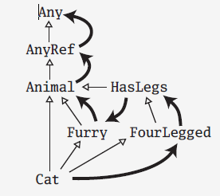
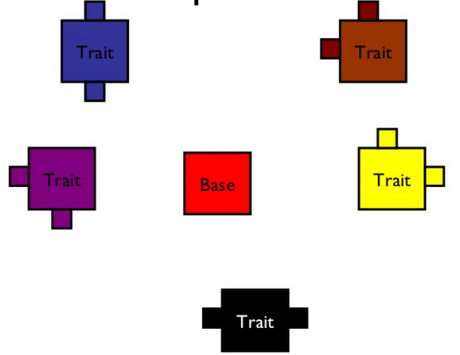
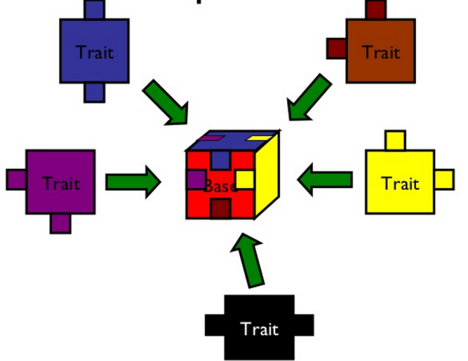
trait.3 Multiple Views
class Animal
trait Furry extends Animal
trait HasLegs extends Animal
trait FourLegged extends HasLegs
class Cat extends Animal with Furry with FourLegged

Slide 15
trait.4 DI with self-type annotation
trait UserRepositoryComponent {
val userRepository: UserRepository
class UserRepository {
def authenticate(user: User): User = {
println("authenticating user: " + user)
user
}
def create(user: User) = println("creating user: " + user)
def delete(user: User) = println("deleting user: " + user)
}
}
trait UserServiceComponent { this: UserRepositoryComponent =>
val userService: UserService
class UserService {
def authenticate(username: String, password: String): User =
userRepository.authenticate(new User(username, password))
def create(username: String, password: String) =
userRepository.create(new User(username, password))
def delete(user: User) = userRepository.delete(user)
}
}
object ComponentRegistry extends UserServiceComponent with UserRepositoryComponent {
val userRepository = new UserRepository
val userService = new UserService
}
trait as
self-type annotation
componenet wired

Slide 16
OOP v.s. FP
Story: A cat catches a bird and eats it.
class Bird
class Cat {
def catch(b: Bird): Unit = ...
def eat(): Unit = ...
}
val cat = new Cat
val bird = new Bird
cat.catch(bird)
cat.eat()
trait Cat
trait Bird
trait Catch
trait FullTummy
def catch(hunter: Cat, prey: Bird): Cat with Catch
def eat(consumer: Cat with Catch): Cat with FullTummy
val story = (catch _) andThen (eat _)
story(new Cat, new Bird)

Slide 17
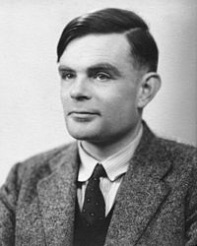
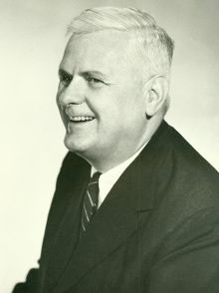
OOP v.s. FP
OO | FP
Composition of objects (nouns) | Composition of functions (verbs)
Encapsulated stateful interaction | Deferred side effects
Iterative algorithms | Recursive algorithms and continuations
Imperative flow | Lazy evaluation
N/A | Pattern matching
Alan Turing
Alonzo Church

Slide 18
FP
First-class functions
Higher-order functions
Currying
Lazy Evaluation
Continuations
Closures
Recursion
Pattern Matching
Decorators

Slide 19

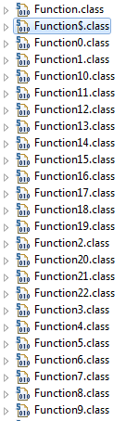
First-class & Higher-order
first-class Functions
def add(x: Int, y: Int): Int = x + y
val sub = (x: Int, y: Int) => x - y
def mul(x: Int, y: Int): Int = x * y
val div = (x: Int, y: Int) => x / y
def hof(x: Int, y: Int, f: (Int, Int) => Int) = f(x, y)
println(hof(1, 2, add))
println(hof(1, 2, sub))
println(hof(1, 2, mul))
println(hof(1, 2, div))
println(hof(1, 2, (x: Int, y: Int) => x + y))
println(hof(1, 2, (x, y) => x - y))
println(hof(1, 2, (_: Int) * (_: Int)))
println(hof(1, 2, _ / _))
println(() => "")
println(() => 5)
println(() => Unit)
println((x: Int) => x + 1)
println((x: Int, y: Int) => x + y)
println((a: Int, b: String, c: Double, d: Long, e: Byte, f: Float) => Unit)
higher-order Functions
lambdas
function traits

Slide 20


Currying & Partial function application
val power = (x: Int, y: Int) => scala.math.pow(x, y)
val p2 = (x: Int) => power(x, 2)
val p3 = (x: Int) => power(x, 3)
println(power)
println(p2, p2(2))
println(p3, p3(2))
def computation(a: Int, b: Int, c: Int, d: Int) = (a + scala.math.pow(b, 2) + scala.math.pow(c, 3) + scala.math.pow(d, 4))
val fill_a = (b: Int, c: Int, d: Int) => computation(1, b, c, d)
val fill_b = (c: Int, d: Int) => fill_a(2, c, d)
val fill_c = (d: Int) => fill_b(3, d)
val fill_d = () => fill_c(4)
println(fill_a, fill_b, fill_c, fill_d)
println(fill_a(2, 3, 4), fill_b(3, 4), fill_c(4), fill_d())
def curriedSum1(x: Int, y: Int) = x + y
def curriedSum2(x: Int)(y: Int) = x + y
def curriedSum3(x: Int) = (y: Int) => x + y
val curriedSum4 = (x: Int) => (y: Int) => x + y
println(curriedSum1(1, 2), curriedSum2(1)(2), curriedSum3(1)(2), curriedSum4(1)(2))
functions currying
partial function application

Slide 21
Lazy Evaluation
Stream for lazy evaluation
lazy val fib1: Stream[Long] =
0 #:: 1 #:: fib1.zip(fib1.tail).map { n => n._1 + n._2 }
(Stream(1, ?),(0,1),0,1)
(Stream(1, 1, ?),(1,1),1,1)
(Stream(1, 1, 2, ?),(1,2),1,2)
(Stream(1, 1, 2, 3, ?),(2,3),2,3)
(Stream(1, 1, 2, 3, 5, ?),(3,5),3,5)
(Stream(1, 1, 2, 3, 5, 8, ?),(5,8),5,8)
(Stream(1, 1, 2, 3, 5, 8, 13, ?),(8,13),8,13)
(Stream(1, 1, 2, 3, 5, 8, 13, 21, ?),(13,21),13,21)
(Stream(1, 1, 2, 3, 5, 8, 13, 21, 34, ?),(21,34),21,34)

Slide 22
Continuations
val res = reset {
shift { k: (Int => Int) =>
k(7)
} + 1
}
println(res)
def foo() = {
println("Once here.")
shift((k: Int => Int) => k(k(k(7))))
}
def bar() = {
1 + foo()
}
def baz() = {
reset(bar() * 2)
}
val res2 = baz()
println(res2)
Continuation-passing style

Slide 23

Closures
context
logic
var more = 1
def addMore(x: Int) = x + more
println(addMore(5))
more = 5
println(addMore(5))
def makeIncreaser(more: Int) = (x: Int) => x + more
val inc1 = makeIncreaser(1)
val inc100 = makeIncreaser(100)
println(inc1(10))
println(inc100(10))

Slide 24
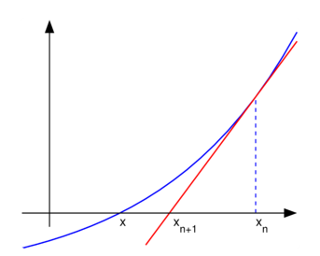

Recursion
val min = 0.000000001
val square = (x: Double) => x * x
val cube = (x: Double) => x * x * x
val mul4 = (x: Double) => x * x * x * x
val f5 = (x: Double) => 4 * x * x * x - 3 - x * x + 9
def derivative(f: (Double => Double), dx: Double) = (x: Double) => (f(x + dx) - f(x)) / dx
def newton_improve(f: (Double => Double), x: Double, g: Double) = g - (f(g) - x) / derivative(f, 0.00001)(g)
def isGoodEnough(value: Double, guess: Double, f: (Double) => Double) = if ((value - f(guess)).abs <= min) true else false
def improve(value: Double, guess: Double, f: (Double, Double) => Double): Double = f(value, guess)
def approximate(value: Double, guess: Double, f: (Double) => Double): Double =
if (isGoodEnough(value, guess, f)) guess
else approximate(value, newton_improve(f, value, guess), f)
tail call recursion

Slide 25
Pattern Matching
def find(x: Any) = x match {
case Math.PI => x
case "hello" => "exactly hello"
case UnOp("-", UnOp("-", e @ Var(_))) => "a " + e
case UnOp("-", UnOp("+", e)) => "b " + e
case List(0, _, _) => "List 3 objs, starts with 0"
case Array(0, 1, _*) => "Array starts with 0, 1"
case (a, b, c) => "find " + a + b + c
case s: String => s.length
case m: Map[_, _] => m.size
case a: Array[Int] => a.size
case pi => pi
//case _ => x
}
constant pattern
constructor pattern
sequence pattern
tuple pattern
type pattern
variable pattern
wildcard pattern

Slide 26
Decorators
decorator
//memory
def memory(f: Int => Int) = new Function1[Int, Int] {
var cache = Map[Int, Int]()
def apply(i: Int) =
if (cache contains i) {
println("cache hit for " + i)
cache(i)
} else {
println("calculate " + i)
val ret = f(i)
cache += (i -> ret)
ret
}
}
val fib: Int => Int = memory {
case 0 => 0
case 1 => 1
case n => fib(n - 1) + fib(n - 2)
}
println(fib(10))
f(a) ⬄ f.apply(a)
def nano() = {
println("Getting nano")
System.nanoTime
}
def delayed(t: => Long) = {
println("In delayed method")
println("Param: " + t)
t
}
println(delayed(nano()))
by name parameter

Slide 27
Advanced Features
Implicits
Extractors
Annotations
Object Equality
Actors
Type Parameterization
Type-Class
Functors, monads, and applicative functors
Integrating with Java

Slide 28
Thank You!!!

